Slide 1
Industry Specific Practices

Slide 2
Problem Definition Standards
The SMART Criteria:
Specific: Clearly define the area of concern (e.g., "Checkout latency" vs. "The site is slow").
Measurable: Quantify the gap (e.g., "5% drop in conversion due to 4-second delays").
Achievable: The problem must be solvable within the project's technical and financial scope.
Relevant: Align with broader business goals.
Time-bound: Define when the problem occurs or the deadline for the fix.
Einstein: "If I had an hour to solve a problem, I'd spend 55 minutes thinking about the problem and five minutes thinking about solutions."

Slide 3
Current vs. Desired State
Item | Current state | Desired state
Process followed
Bottlenecks
Impact

Slide 4
About the Problem
Who: Which users or systems are affected?
What: What is the specific failure or inefficiency?
Where: Is it in the UI, the database, or a specific geographic region?
When: Does it happen under load? Only on mobile?
Why: What is the root cause?
How: How is the problem currently being bypassed (the "workaround")?
How Much: What is the cost of doing nothing

Slide 5
ISO/IEC/IEEE 29148:2018
Element | Description
Context
Stakeholders | List of parties impacted (Users, DevOps, Legal, etc.).
Scope Boundary | Explicitly stating what the problem is not to avoid scope creep.
Success Criteria | Definition of Done (DoD) from a problem-resolution perspective.

Slide 6
Requirements
Requirements Engineering Life Cycle
Requirements Engineering Document
Categorizing Different Types of Requirements
Requirements Traceability
Change Management Criteria
INVEST Checklist

Slide 7
Requirements Engineering Life Cycle
Elicitation: Gathering needs via interviews, workshops, surveys, and observation.
Analysis: Negotiating conflicts (e.g., Marketing wants speed, Security wants friction) and checking feasibility.
Specification: Documenting the requirements (User Stories, PRDs, or SRS).
Validation: Confirming with the stakeholder that "Yes, this is actually what I meant."

Slide 8
Requirements Engineering Document

Slide 9
Categorizing Different Types of Requirements
Functional Requirements (FRs): What the system does (e.g., "The user can reset their password").
Non-Functional Requirements (NFRs): How the system is (e.g., Performance, Security, Scalability). These are often called "Quality Attributes.“
Scalability
Security and Compliance
Maintainability and Extensibility
Performance and Stress
Others
Domain Requirements: Operational Domain

Slide 10
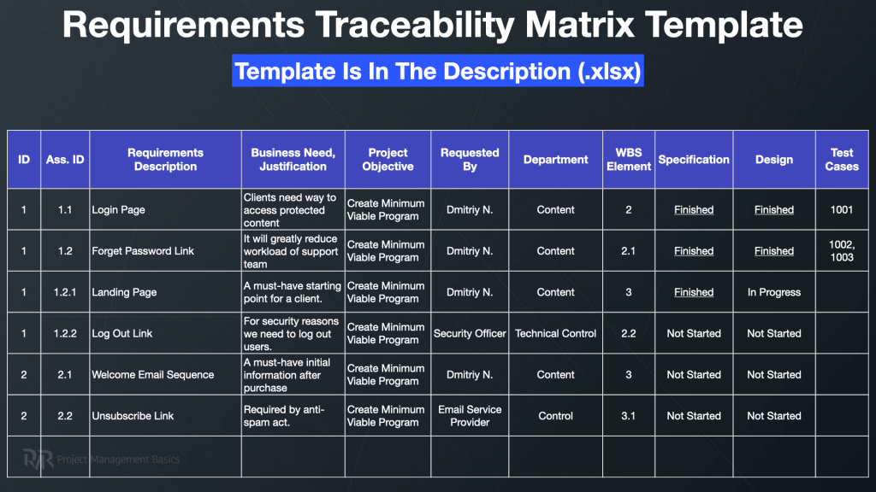

Slide 11
Change Management Criteria

Slide 12
INVEST Checklist
Letter | Principle | Red Flag
I | Independent | "We can't start this until Story B is 100% done."
N | Negotiable | "The document says we must use a specific API library."
V | Valuable | "I'm refactoring code, but the user sees no change."
E | Estimable | "I have no idea if this will take two days or two months."
S | Small | "This story will likely take the whole 3-week sprint."
T | Testable | "The UI should feel 'snappy' and 'intuitive'."

Slide 13
Design Engineering
High-Level Design (HLD)
System Architecture :
Choosing between Monolithic, Microservices, or Serverless architectures.
Database Design: Defining Entity-Relationship Diagrams (ERDs) and choosing between SQL or NoSQL based on data consistency needs.
Integration Points:
Low-Level Design (LLD)
Class & Sequence Diagrams:
Component Logic
UI/UX Design:

Slide 14
Key Activities & Implementation
Requirement Mapping
Design Diagrams (UML Diagrams – Staruml, Lucidchart Design Templates
Wireframes Figma Community Templates
ER Diagram-Untitled - dbdiagram.io
Database Schema - Untitled - dbdiagram.io

Slide 15
Cohesion & Coupling
Identify the Cohesion and Coupling for major modules
Arriving at number of modules for the Project

Slide 16
Design Pattern Usage
Identify the important scenarios and suggest Patterns
Map Classes to appropriate patterns
Suggest modifications required for existing patterns(if required)

Slide 17
Architectural Styles
Usage of appropriate Architectural Styles

Slide 18
Technology Stack
Identify programming languages on Module basis
Frameworks
Infrastructure-Hardware, Databases and others

Slide 19
Interface Design
API Design for Class/Component/Module Level Interactions
User Interface (UI) / User Experience (UX)-Wire Frames

Slide 20
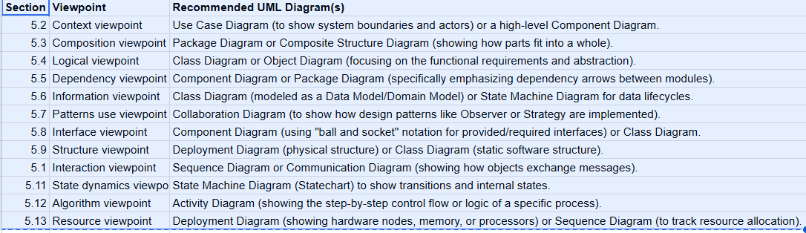
UML Diagrams
Static Views (Structure): Class, Component, Package, and Deployment diagrams.
Dynamic Views (Behavior): Sequence, Activity, and State Machine diagrams.
Functional Views: Use Case diagrams.

Slide 21
Design Document

Slide 22
Coding Practices
Clean Code & Readability
Descriptive Naming
DRY (Don't Repeat Yourself)
KISS (Keep It Simple, Stupid):
Prioritize clear, straightforward logic over "clever" code.
Defensive Programming & Testing
Unit Testing
Input Validation of external inputs/parameters
Error Handling
Collaborative Workflows
Code Reviews by peers
Documentation and Tooling
Comments that explain "Why," not "What“
Automated Linting and Formatting

Slide 23
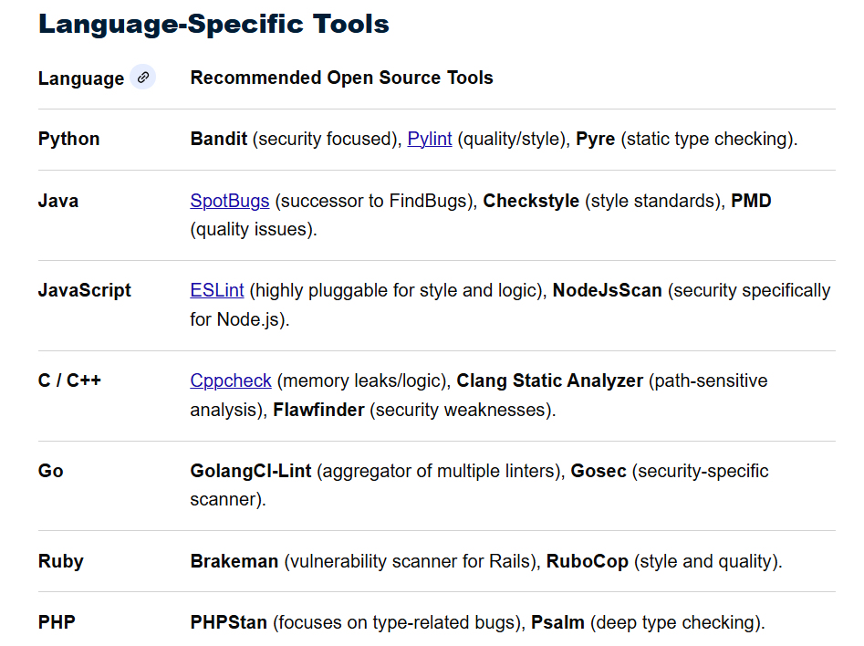
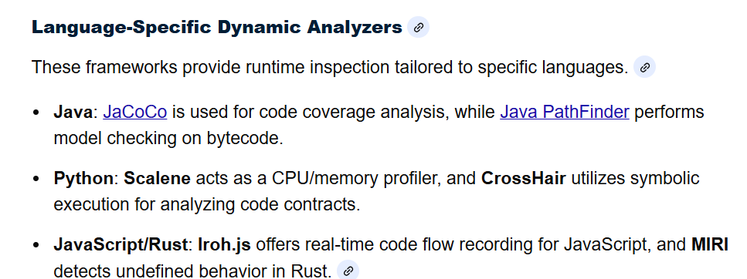
Code Analyzers
Static Code Analyzer
https://www.sonarsource.com
Dynamic Code Analysis

Slide 24
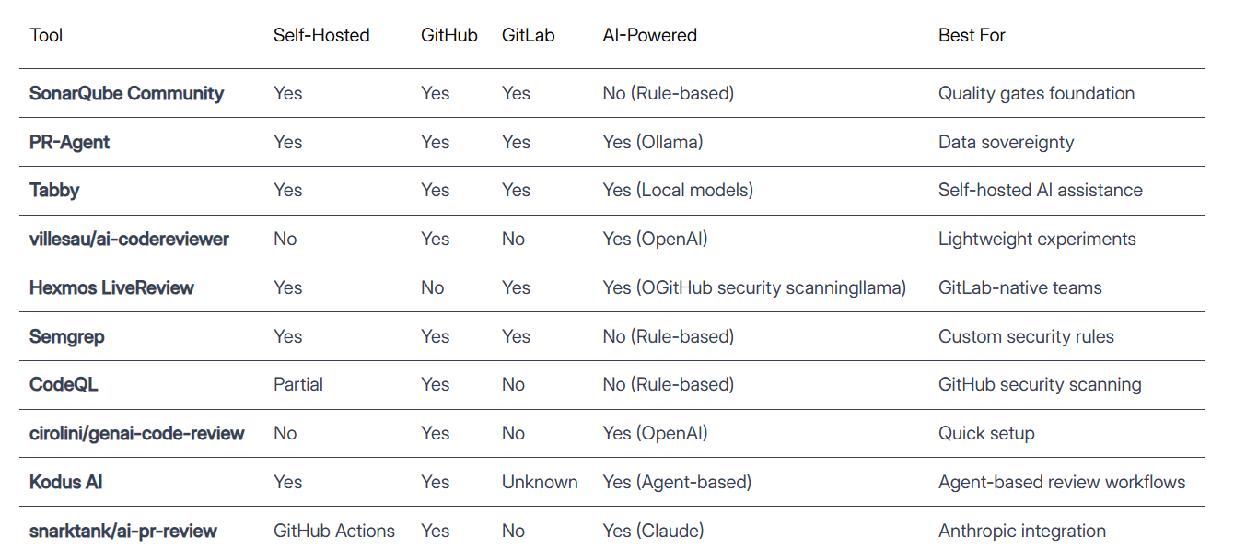
AI Code Analysis Tools

Slide 25
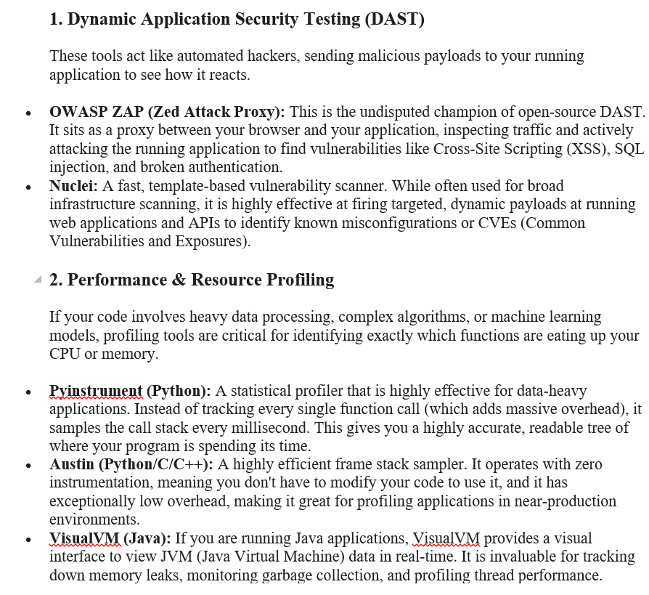
Open Source Dynamic Code Analyzers for FSD Projects

Slide 26
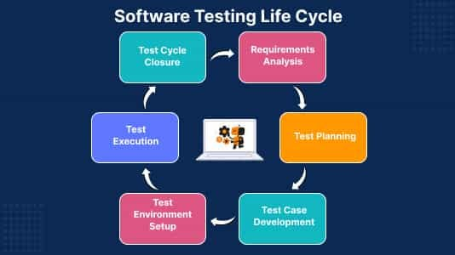
Testing
Test Case Life Cycle

Slide 27
Testing
Use Templates
https://strongqa.com/qa-portal/testing-docs-templates

Slide 28
Deployment Checklist
Checklist for Application Deployment | Techolution

